Slide 1
Image Caption Generation
Satyankar 2000270100137
Yuvika Singh 2000270100197
Vanshika Singh 2000270100180
Vaibhav Tiwari 2000270100178

Slide 2
Contents
Introduction
Pre -requisites
Overall work flow
Methodologies
Existing Approaches/Related Works
Our Approach
Graphs
Applications
Conclusions
References

Slide 3

1. Introduction
Image caption generator is a process of recognizing the context of an image and annotating it with relevant captions using deep learning and computer vision.It includes labeling an image with English keywords with the help of datasets provided during model training.
Objectives
Implement a caption generation model using a CNN to condition a LSTM language model.
Focuses on advancing image captioning using deep learning.
Accuracy improvement by training methods to create precise and contextually relevant descriptions

Slide 4
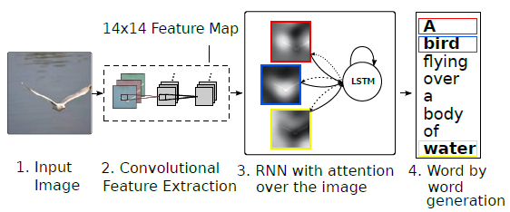
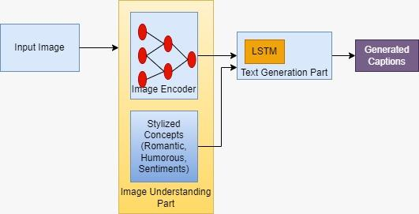
First, the input dataset is acquired where the batch of image dataset is selected. Then the image is preprocessed. After preprocessing, the image is extracted using CNN and image caption is generated using extracted features using LSTM. Now we will combine this model architecture in one model and that is our final model which will generate caption from images.

Slide 5
2. Pre-requisites
This project requires good knowledge of Deep learning, Python, working on Jupyter notebooks, Keras library, Numpy, and Natural language Processing.
Necessary libraries -
TensorFlow
Keras
Pandas
NumPy
nltk ( Natural language toolkit)
Jupyter- IDE

Slide 6
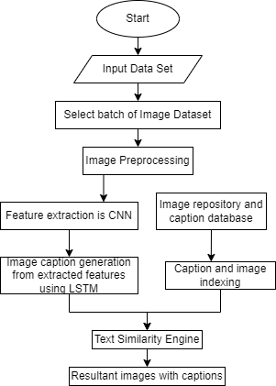
3. Overall Work Flow

Slide 7
4. Methodologies
Deep Learning -
Deep Learning is a subset of Machine Learning. In Machine Learning features are provided manually. Whereas Deep Learning learns features directly from the data.
Convolutional Neural Network (CNN) -
CNN is a collection of one or more convolutional layers. Each layer applies a specified number of convolutional filters to an image, performs mathematical functions on the sub region, ultimately producing a single value for the output. The pooling layer takes image data extracted by the convolutional layer as input. It aims to reduce dimensionality of feature.

Slide 8
The last fully connected layer utilizes a softmax initiation work for characterizing the produced highlights of the information picture into different classes in light of the training dataset and after completing this layer then we get an output.
3) Recurrent neural network(RNN) -
Recurrent neural network is a class of simulated neural system where associations between units shape a coordinated diagram along an arrangement.
4) Long Short Term Memory (LSTM) -
LSTM are a special kind of RNN, capable of learning long-term dependencies. The advantage of an LSTM cell compared to a common recurrent unit is its cell memory unit. The cell vector has the ability to encapsulate the notion of forgetting part of its previously-stored memory, as well as to add part of the new information.

Slide 9
5. Existing Approaches/Related Works
S. No. | Year | Author’s Name | Methodology | Title of the Paper
1. | 2015 | Vinyals et al | CNN-RNN framework | Show and Tell
2. | 2015 | K Xu et al | Attention Mechanism | Show, Attend and Tell
3. | 2017 | Rennie et al | Reinforcement Learning | Actor-Critic Sequence Training
4. | 2017 | J Li et al | Adversarial Training | Adversarial Learning for Neural Dialogue Generation
5. | 2018 | Parmar et al | Transformer Based Mechanism | Image Transformer

Slide 10
S. No. | Year | Author’s Name | Methodology | Title of the Paper
6. | 2019 | Liunian Harold Li et al. | Multimodal Approaches | Unified Vision-Language Pre-training
7. | 2020 | Himanshu et al. | Retrieval Based Approach | Image captioning: a comprehensive survey
8. | 2021 | Guerin et al. | Zero-shot and Few-shot Learning | Meta-Learning for Low-Resource Image Captioning
9. | 2021 | Mokady et al. | CLIP Based Approach | Clipcap: Clip prefix for image captioning
10. | 2023 | Wang et al. | CLIP Based Approach | Efficient image captioning for edge devices

Slide 11
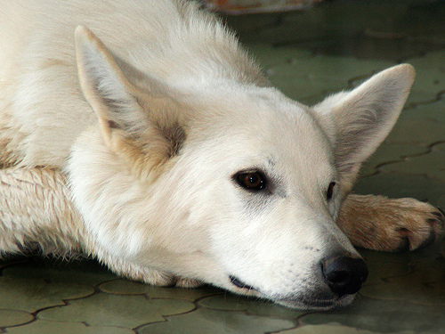
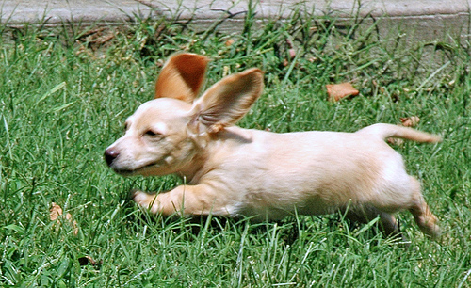
6.1. Get Dataset
Caption1: closeup of white dog that is laying its head on its paws
Caption 2: large white dog lying on the floor
Caption 3: white dog has its head on the ground
Caption 4: white dog is resting its head on tiled floor with its eyes open
Caption 5: white dog rests its head on the patio bricks
Flickr8k Dataset:
8000 images
5 captions for each image
Larger datasets:
Flickr30k
MSCOCO
Caption 1: little tan dog with large ears running through the grass
Caption 2: playful dog is running through the grass
Caption 3: small dogs ears stick up as it runs in the grass
Caption 4: the small dog is running across the lawn
Caption 5: this is small beige dog running through grassy field

Slide 12
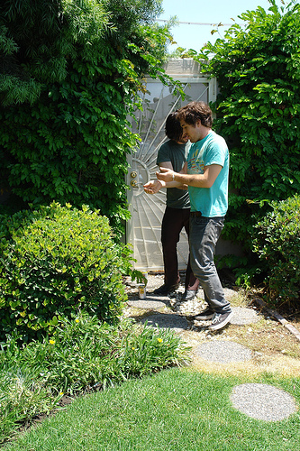
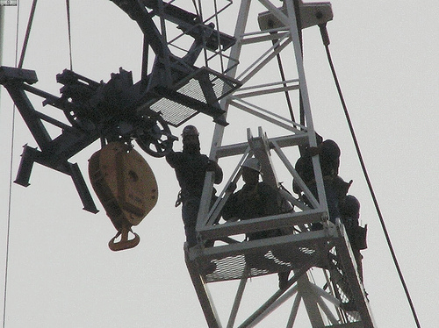
6.2 Get Dataset
Caption1: Two young guys with shaggy hair look at their hands while hanging out in the yard .
Caption 2: Two young , White males are outside near many bushes
Caption 3: Two men in green shirts are standing in a yard .
Caption 4: A man in a blue shirt standing in a garden .
Caption 5: Two friends enjoy time spent together .
Flickr30k Dataset:
31783 images
5 captions for each image
Larger datasets:
Visual Genome
MSCOCO
Caption 1: Several men in hard hats are operating a giant pulley system .
Caption 2: Workers look down from up above on a piece of equipment .
Caption 3: Two men working on a machine wearing hard hats .
Caption 4: Four men on top of a tall structure .
Caption 5: Three men on a large rig.

Slide 13

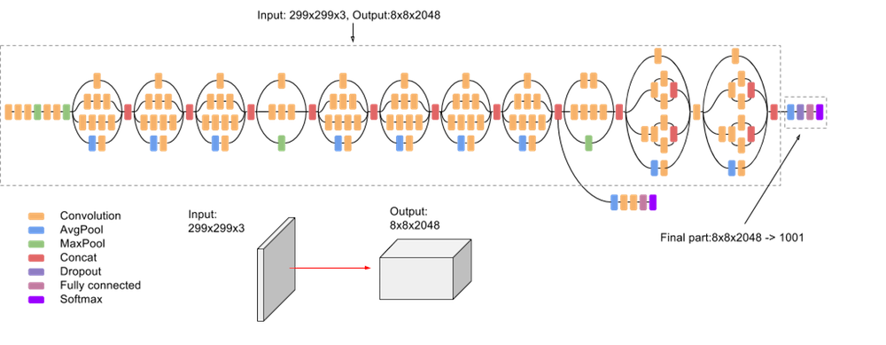
6.3 Prepare Photo Data
CNN models to extract features:
Remove last layers used for predicting
Preprocess image
Calculate and save features
VGG16
134,260,544 parameters
Input: 224 x 224 image
Output: 4096 feature vector
InceptionV3
21,768,352 parameters
Input: 299 x 299 image
Output: 2048 feature vector

Slide 14
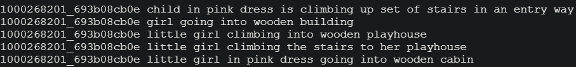
6.4 Prepare Text Data
Load all descriptions
Create a dictionary mapping descriptions to images
Clean descriptions:
Convert all the words to lowercase
Remove all the punctuation
Remove words one character long
Remove words with numbers
Create a vocabulary
8,763 unique words
Save descriptions to a file

Slide 15
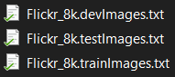
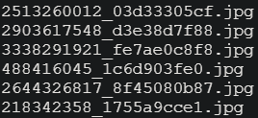
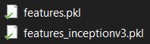
6.5 Load Data
Predefined subsets:
Train 6000
Validation 1000
Test 1000
Captions
Read from saved files
Add startseq and endseq
Image features
Read from saved file

Slide 16
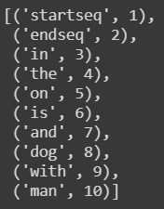
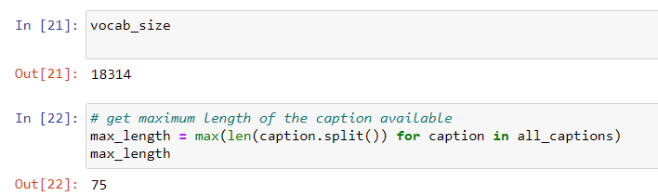
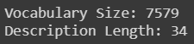
6.6 Encode Text Data
Convert descriptions to lists of words
Use a tokenizer
Map from words of the vocabulary to integers
Calculate vocabulary size
Compute maximum caption length
Flickr8k
Flickr30k

Slide 17
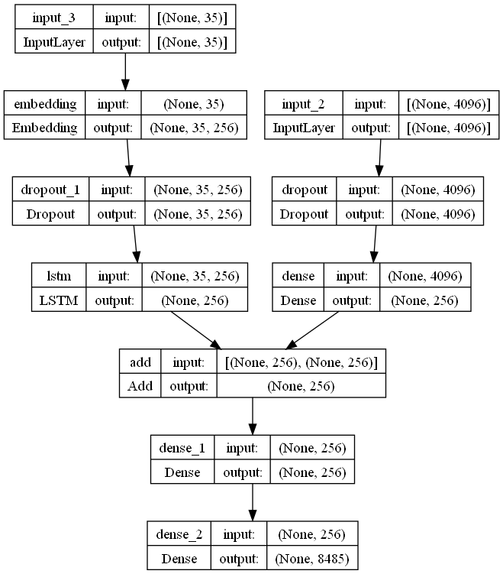
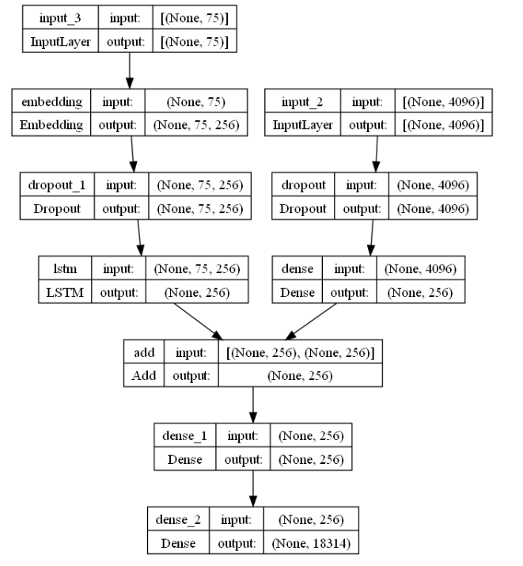
6.7.1 Define Model
Flickr8k
Flickr30k

Slide 18
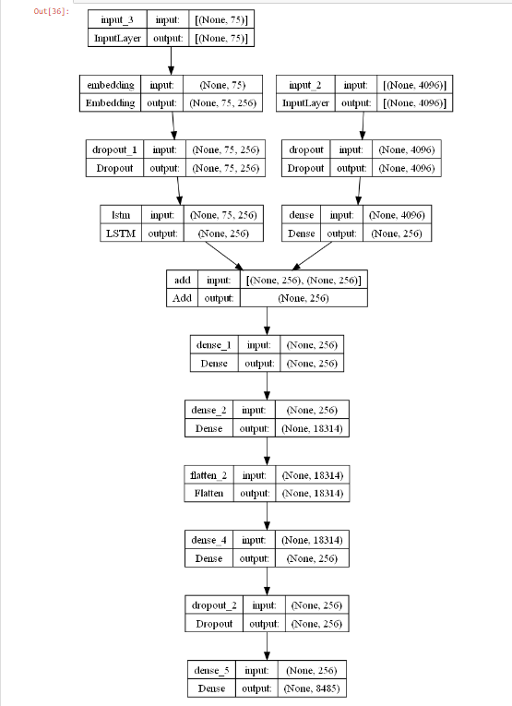
6.7.2 Define Model
Flickr8K
+
Flickr30K

Slide 19
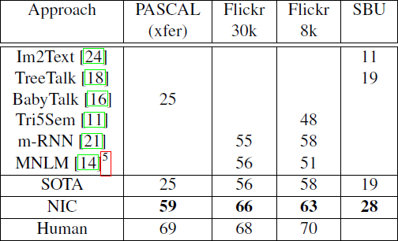
6.8.1 Evaluate Model
Sampling:
Take the best word at each time step
Beam Search
Considers the k best sentences at each time step
Increases the chance of getting a better description

Slide 20
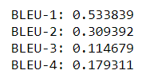
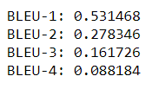
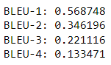
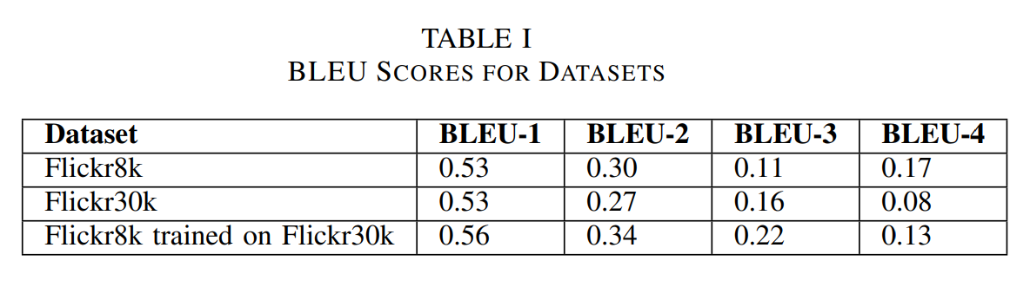
6.8.2 BLEU Scores
Flickr30K
Flickr8K
Flickr8K trained on Flickr30K

Slide 21
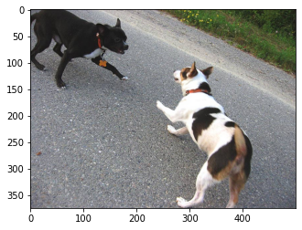
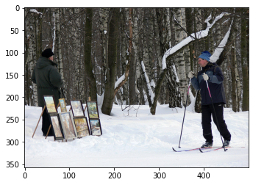
6.9 Generate Captions
Actual Captions :
black dog and spotted dog are fighting
black dog and tri-colored dog playing with each other on the road
black dog and white dog with brown spots are staring at each other in the street
two dogs of different breeds looking at each other on the road
two dogs on pavement moving toward each other
Predicted Captions :
two dogs play with each other in the grass
Actual Captions :
man in hat is displaying pictures next to skier in blue hat
man skis past another man displaying paintings in the snow
person wearing skis looking at framed pictures set up in the snow
skier looks at framed pictures in the snow next to trees
man on skis looking at artwork for sale in the snow
Predicted Captions :
two people are hiking up snowy mountain

Slide 22
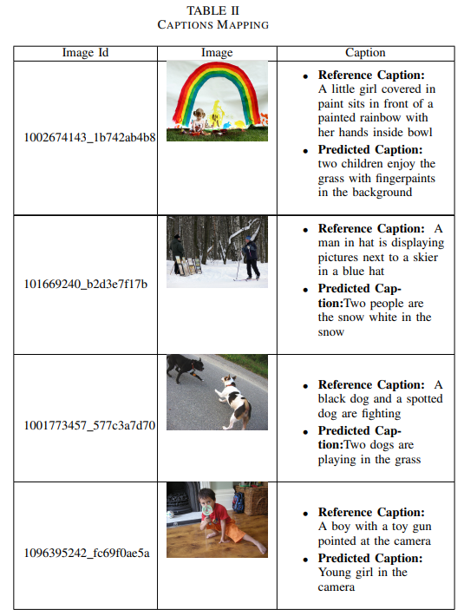

Slide 23
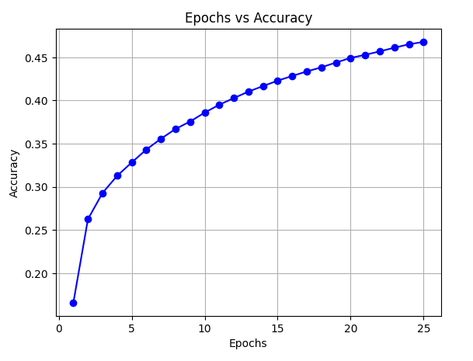
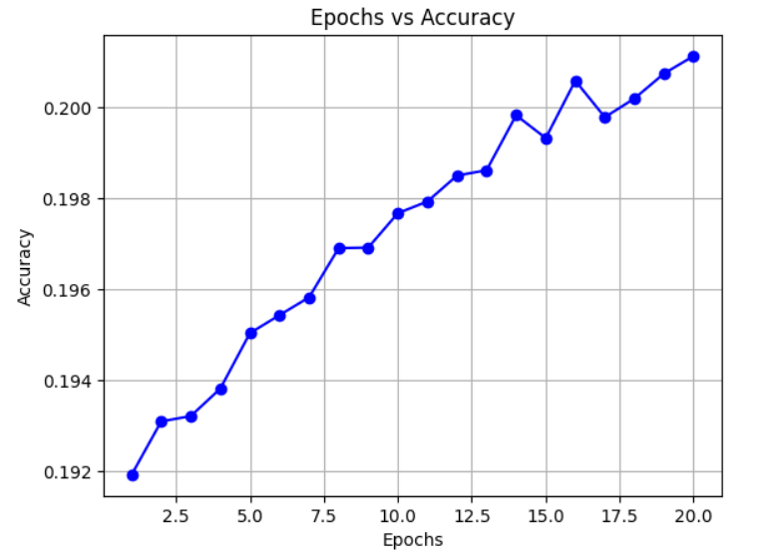
7.1 Epoch v/s Accuracy Graph
Flickr8K
Flickr30K trained on Flickr8K

Slide 24
8. Applications
Healthcare: Generating descriptions for X-ray images to assist radiologists in diagnosing medical conditions, such as identifying fractures or abnormalities.
Security and Surveillance: Describing events and objects in security camera footage to aid in identifying security threats or incidents in real time.
Education: Enhancing educational materials by providing image captions in textbooks to help students better understand complex diagrams and illustrations.
Agriculture: Automatically generating captions for images of crops in the field to help farmers monitor the health of their plants and identify diseases.
Robotics: Enabling a robot in a warehouse to generate captions for objects it encounters, aiding in navigation and object recognition for tasks like picking and packing.

Slide 25
9. Conclusions and Future Work
Conclusion :
Our machine learning model effectively demonstrates the capability to infer detailed visual content from input images.
The model adeptly translates this inferred visual information into descriptive captions, highlighting its proficiency in generating contextually relevant textual outputs.
We introduced and implemented image region as CNN features and RNN features.
Our main achievements for Flickr30K dataset is increased accuracy and reduce loss.
Future Work :
Apply Transfer Learning scheme
Enhance BLEU score
Train model on bigger datasets comparatively
Evaluate Real-world Deployment

Slide 26
10. References
Shuang Bai and Shan An. A survey on automatic image caption generation. Neurocomputing, 311:291–304, 2018.
Ahmed Elhagry and Karima Kadaoui. A thorough review on recent deep learning methodologies for image captioning. arXiv preprint arXiv:2107.13114, 2021.
Taraneh Ghandi, Hamidreza Pourreza, and Hamidreza Mahyar. Deep learning approaches on image captioning: A review. ACM Computing Surveys, 56(3):1–39, 2023.
Xiaodong He and Li Deng. Deep learning for image-to-text generation: A technical overview. IEEE Signal Processing Magazine, 34(6):109–116, 2017.
MD Zakir Hossain, Ferdous Sohel, Mohd Fairuz Shiratuddin, and Hamid Laga. A comprehensive survey of deep learning for image captioning. ACM Computing Surveys (CsUR), 51(6):1–36, 2019.
Xiaoxiao Liu, Qingyang Xu, and Ning Wang. A survey on deep neural network-based image captioning. The Visual Computer, 35(3):445–470,2019.
Yue Ming, Nannan Hu, Chunxiao Fan, Fan Feng, Jiangwan Zhou, and Hui Yu. Visuals to text: A comprehensive review on automatic image captioning. IEEE/CAA Journal of Automatica Sinica, 9(8):1339–1365, 2022.
Matteo Stefanini, Marcella Cornia, Lorenzo Baraldi, Silvia Cascianelli, Giuseppe Fiameni, and Rita Cucchiara. From show to tell: A survey on deep learning-based image captioning. IEEE transactions on pattern analysis and machine intelligence, 45(1):539–559, 2022.
Licheng Jiao and Jin Zhao. A survey on the new generation of deep learning in image processing. Ieee Access, 7:172231–172263, 2019.

Slide 27
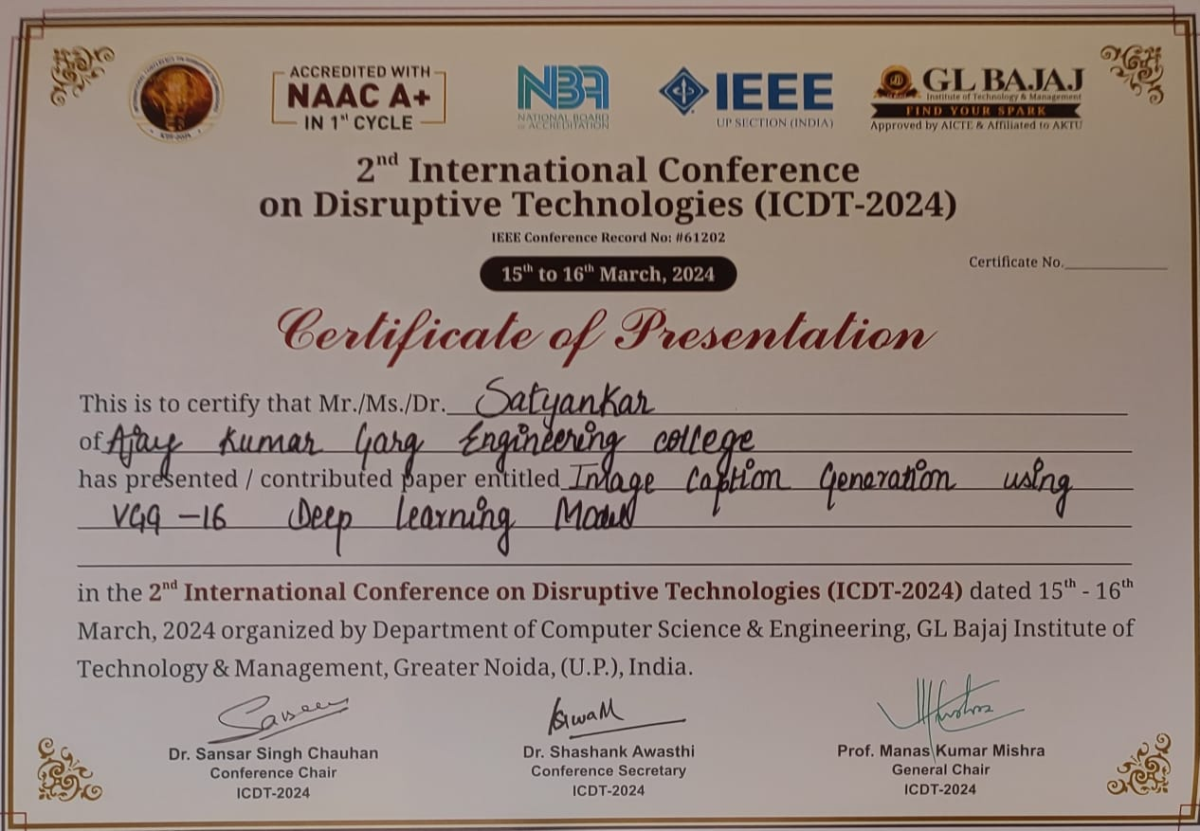

Slide 28
